Slide 1
INDICATIONS FOR ACL RECONSTRUCTION! ARE WE OPERATING TOO MUCH ?

Slide 2
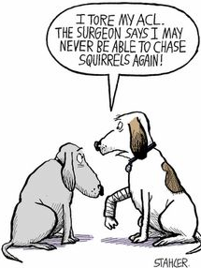
ACL: THE FOOTBALLER’S NIGHTMARE?
Despite their relatively low incidence (<1% of all injuries), anterior cruciate ligament (ACL) lesions are the most attention-drawing pathology in football medicine.
While some decades ago it was a career-ending injury for a footballer, progress in athlete healthcare has led to a return to football outcome at the same level as before the injury in 90% of patients.
However, there is an increased risk of suffering a new knee injury (especially overuse injury) on return to elite football after an ACL injury.
EPIDEMIOLOGY OF INJURY IN FOOTBALL– Cristiano Eirale, Qatar
and Jan Ekstrand, Sweden

Slide 3
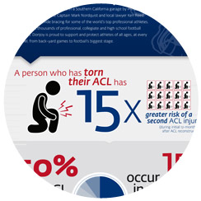
About ACL Injury - The Facts
Young people between the ages of 15-25 account for half of all ACL injuries. In more recent football studies, a re-injury rate between 12 and 30% has been reported.
A person who has torn their ACL has a 15 times greater risk of a second ACL injury during the initial 12 months after ACL reconstruction
Risk of ACL injury to the opposite knee is two times that of the restructured knee
Many athletes (30%) don’t return to sport after ACL reconstruction due to fear of re-injury
The importance of correct guidelines and specific medical and physical tests in the return to play decision.
Griffin LY, Albohm MJ, Arendt, EA, et al. Understanding and Preventing Noncontact Anterior Cruciate Ligament Injuries: A Review of the Hunt Valley II Meeting, January 2005. American Journal of Sports Medicine. 2006 34:9. 1512-1532.
Paterno MV. Paper #2. Presented AOSSM Annual Meeting; July 11-14, 2013; Chicago.
Wright RW, Magnussen RA, Dunn WR, Spindler KP, Ipsilateral Graft and Contralateral ACL Rupture at Five Years or More Following ACL Reconstruction. Journal of Bone and Joint Surgery, Am. 2011;93:1159-1165.
Spindler et al. Return to High School and College-Level Football After Anterior Cruciate Ligament Reconstruction. Am J Sports Med. Published online Aug. 24, 2012.

Slide 4
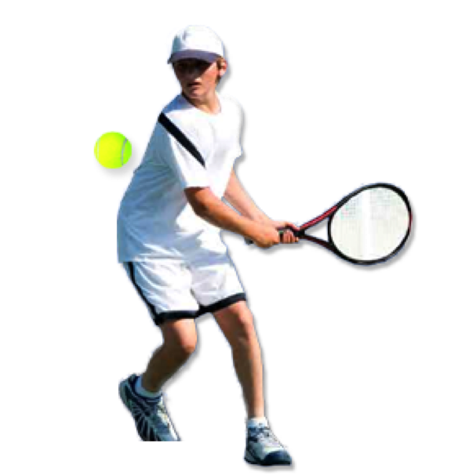
ACL - About 48,700,000 results
ACL conservative 419,000
ACL surgical 619,000
ACL surgery 1080,000

Slide 5
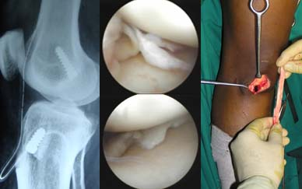
ACL - About 4,420,000 results
ACL conservative 168,000
ACL surgical 2,350,000
ACL surgery 2,360,000

Slide 6
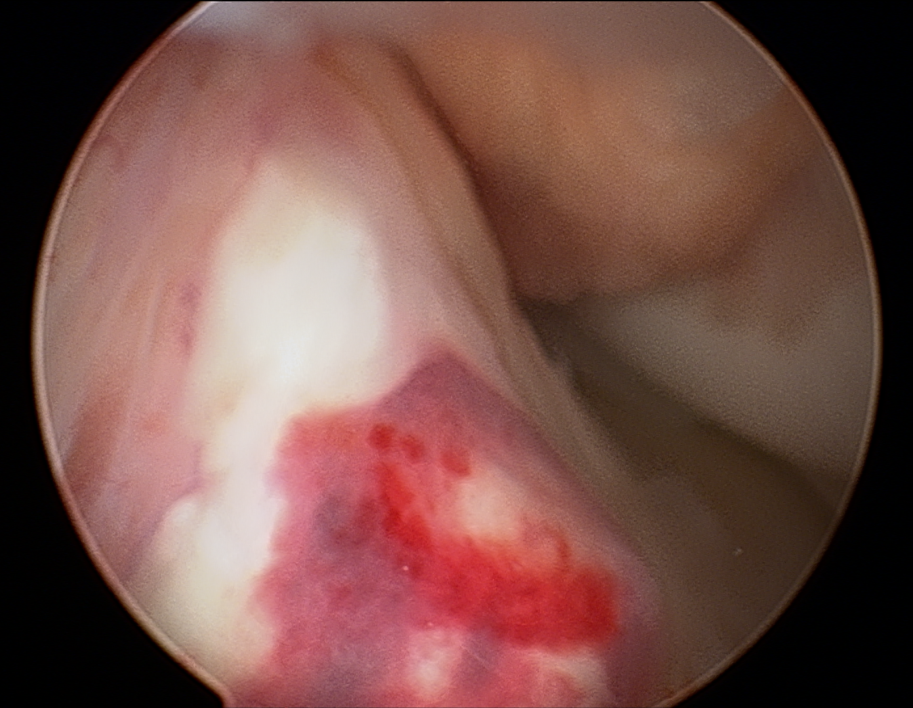
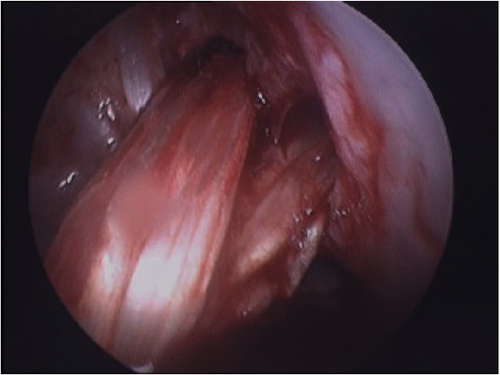
Number of studies

Slide 7
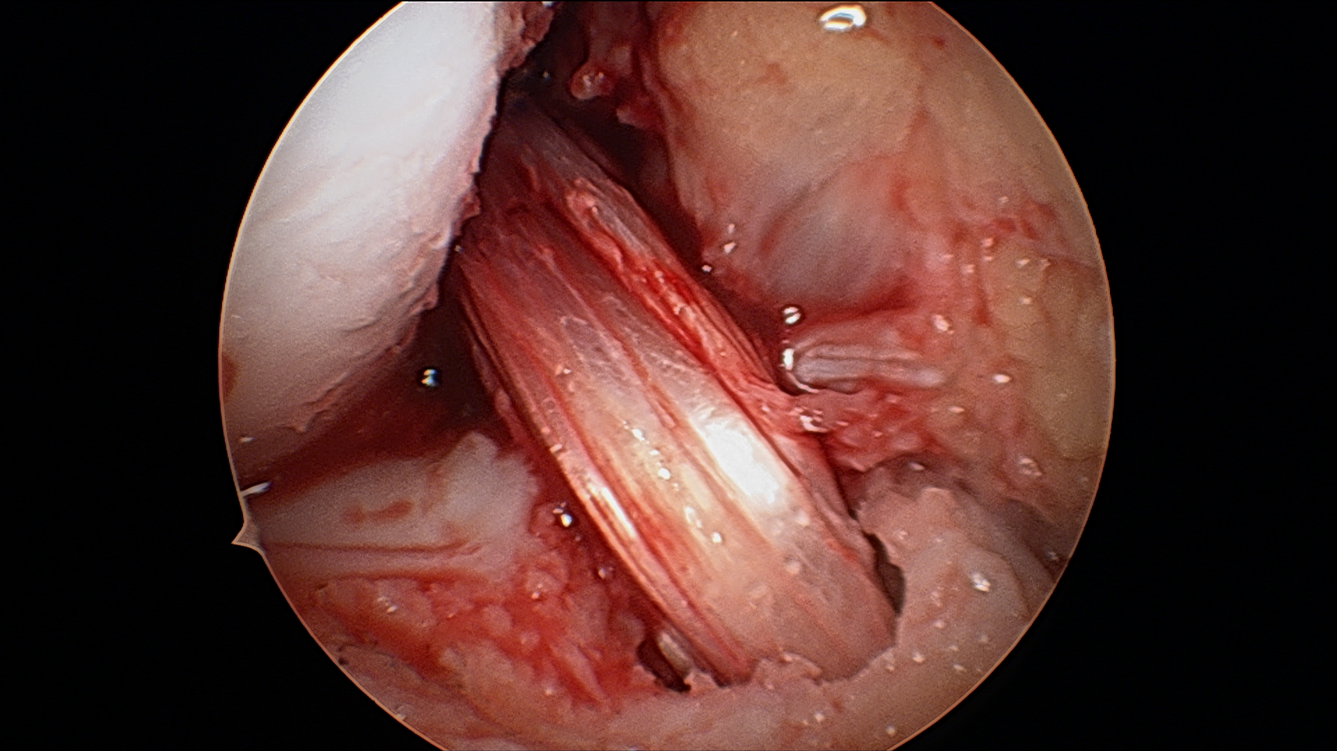
ACL IN LITERATURE
TOO MUCH SURGERY ? DIFFICULT TO SAY!

Slide 8
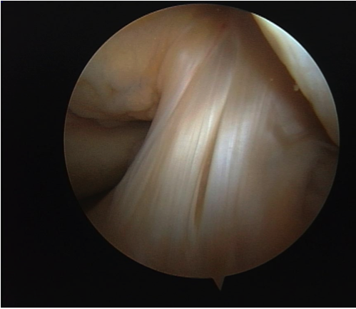
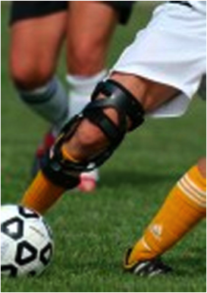
ACL - Unfortunately results of most studies (populations) cannot be compared because of the following reasons (differences!)
TYPE OF SPORTS

Slide 9
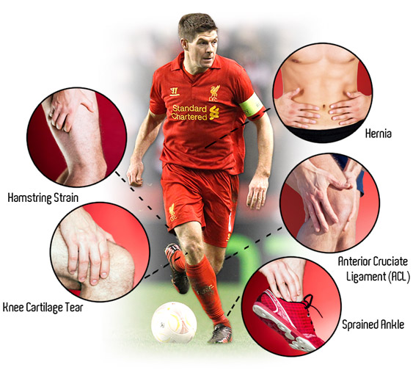
RECOMMENDATION AND ALGORITHM FOR ACL RECONSTRUCTION 2005

Slide 10
Surgical versus conservative interventions for anterior cruciate ligament ruptures in adults Eric Linko^{1,*}, Arsi Harilainen², Antti Malmivaara³, Seppo Seitsalo⁴Editorial Group: Cochrane Bone, Joint and Muscle Trauma GroupPublished Online: 20 APR 2005
Objectives: Evaluation of the effect of surgical reatment compared with conservative treatment of anterior cruciate ligament (ACL) rupture.
Search methods: We searched the Cochrane Bone, Joint and Muscle Trauma Group Specialised Register (January 2005), the Cochrane Central Register of Controlled Trials (The Cochrane Library Issue 1, 2005), MEDLINE (1966 to January Week 3 2005), EMBASE (1988 to 2005 Week 05), MEDIC (1978 to January 1999), Current Contents (9.2.1998 to 1.2.1999), BIOSIS (1970 to December 1998), reference lists of articles and consulted trialists and experts.
Authors' conclusions: There is insufficient evidence from randomised trials to determine whether surgery or conservative management was best for ACL injury in the 1980s, and no evidence to inform current practice. Good quality randomised trials are required to remedy this situation.

Slide 11
Br J Sports Med 2009;43:347-351 Original article Ten year follow-up study comparing conservative versus operative treatment of anterior cruciate ligament ruptures. A matched-pair analysis of high level athletesD E Meuffels, M M Favejee, M M Vissers, M P Heijboer, M Reijman, J A N Verhaar+
We conclude that the instability repair using a bone-patella-tendon-bone anterior cruciate ligament reconstruction is a good knee stabilizing operation.
Both treatment options however show similar patient outcome at 10 year follow up

Slide 12
Frobell Richard B, Roos Harald P, Roos Ewa M, Roemer Frank W, Ranstam Jonas, Lohmander L Stefan et al. Treatment for acute anterior cruciate ligament tear: five year outcome of randomised trial BMJ 2013; 346 :f232
Abstract
Objective To compare, in young active adults with an acute anterior cruciate ligament (ACL) tear, the mid-term (five year) patient reported and radiographic outcomes between those treated with rehabilitation plus early ACL reconstruction and those treated with rehabilitation and optional delayed ACL reconstruction.
Conclusion In this first high quality randomized controlled trial with minimal loss to follow-up, a strategy of rehabilitation plus early ACL reconstruction did not provide better results at five years than a strategy of initial rehabilitation with the option of having a later ACL reconstruction. Results did not differ between knees surgically reconstructed early or late and those treated with rehabilitation alone.
These results should encourage clinicians and young active adult patients to consider rehabilitation as a primary treatment option after an acute ACL tear.

Slide 13
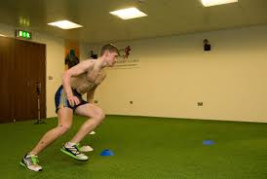
Am J Sports Med. 2012 Nov;40(11):2517-22. Return to play and future ACL injury risk after ACL reconstruction in soccer athletes from the Multicenter Orthopaedic Outcomes Network (MOON) group.Brophy RH1, Schmitz L, Wright RW, Dunn WR, Parker RD, Andrish JT, McCarty EC, Spindler KP.
This study represents a large, long term follow up of return to play in soccer athletes following ACL reconstruction. These athletes can get back to play despite the decline in participation over time.
Younger and male soccer athletes are more likely to return to play after ACL reconstruction.
There is a high risk for future ACL injury, especially in female soccer players, and ACL reconstruction in the non-dominant limb may increase the risk for future ACL injury in the dominant limb.
Soccer players who undergo ACL reconstruction may benefit from and be the ideal population for targeted injury prevention programs.

Slide 14
NATIONAL CONCEPTS EVOLUTION
SWEDISH POWER
NEW REALITIES
EXTENDED INDICATIONS
?
TASK FOR SPAT
IN THE FUTURE?

Slide 15
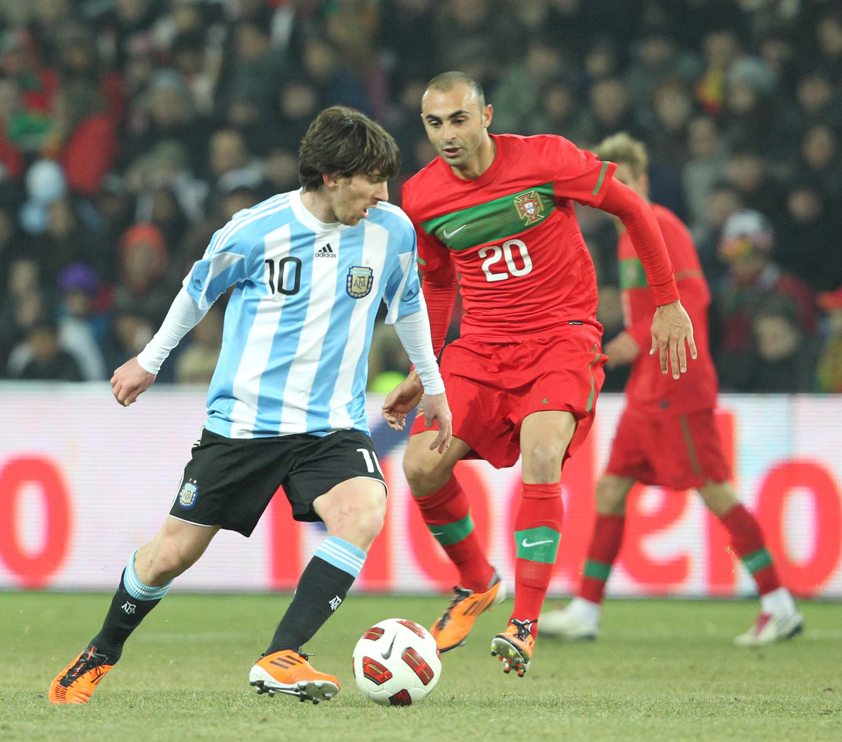
Incidence of ACL reconstruction in an active population reported to be 30 per 100,000
Estimated that there are around 300,000 ACL reconstructions performed per year in the USA. About 100.000 anterior cruciate ligament (ACL) reconstructions are performed currently in Europe per year.
Reported success rate of primary ACL reconstruction: 75 ‐ 97%
Therefore, a significant number of patients who undergo ACL reconstruction may have a less than satisfactory outcome

Slide 16
Cost of ACL surgery around the world:
Knee Ligament Surgery in Spain from $2,726
Knee Ligament Surgery in India from $3,963
Knee Ligament Surgery in Poland from $4,600
Knee Ligament Surgery in Mexico from $5,073
Knee Ligament Surgery in Thailand from $5,118
Knee Ligament Surgery in Turkey from $8,645
Knee Ligament Surgery in the United Kingdom from $11,000
Knee Ligament Surgery in Australia from $14-16,000
Knee Ligament Surgery in the United States from $22,000
?

Slide 17
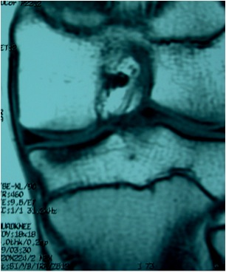
CONSIDERATIONS BEFORE DECISIONS

Slide 18
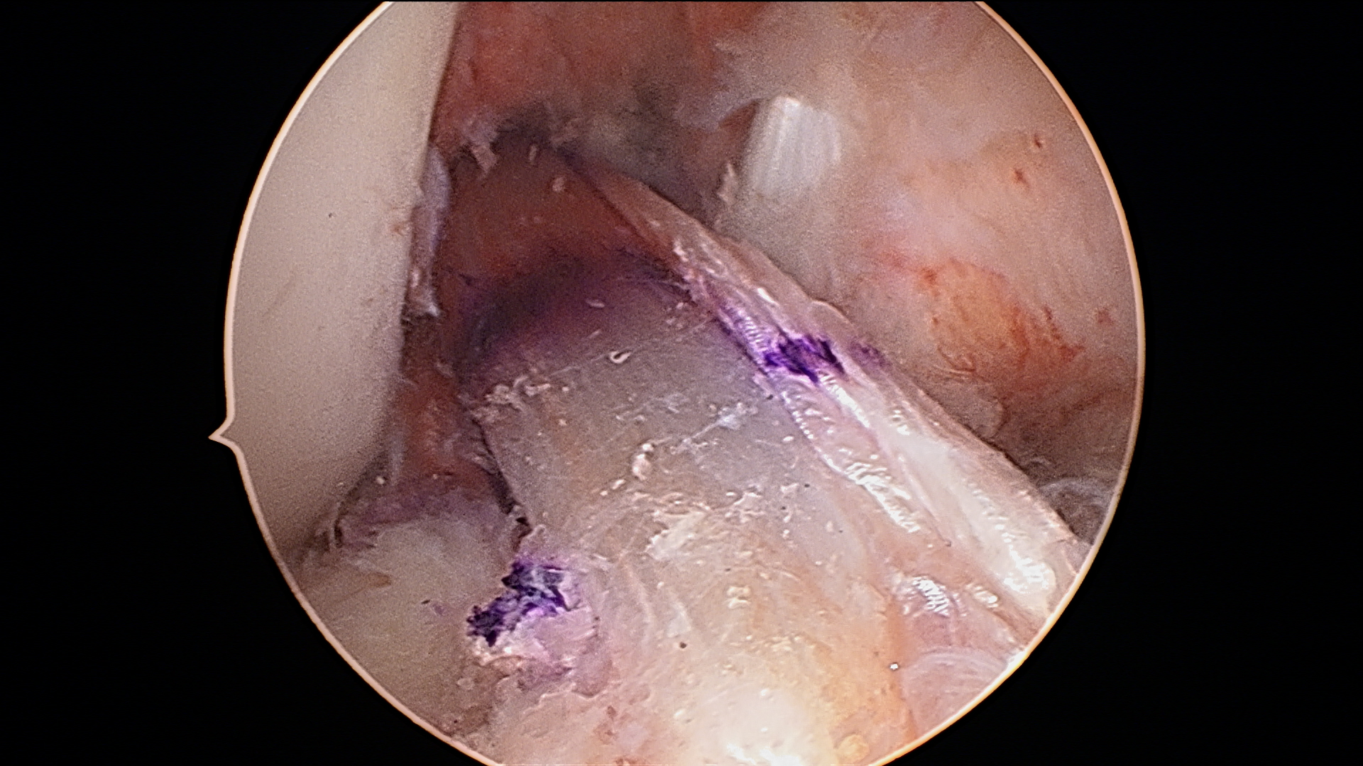
CONCERNS ABOUT ACL SURGERY AND WHAT COULD MADE THE DIFERENCE
OBESITY

Slide 19
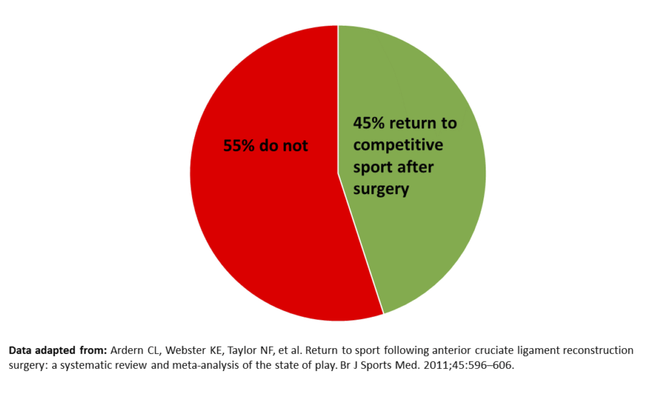
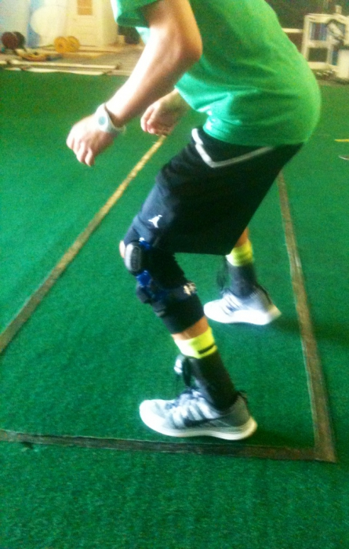
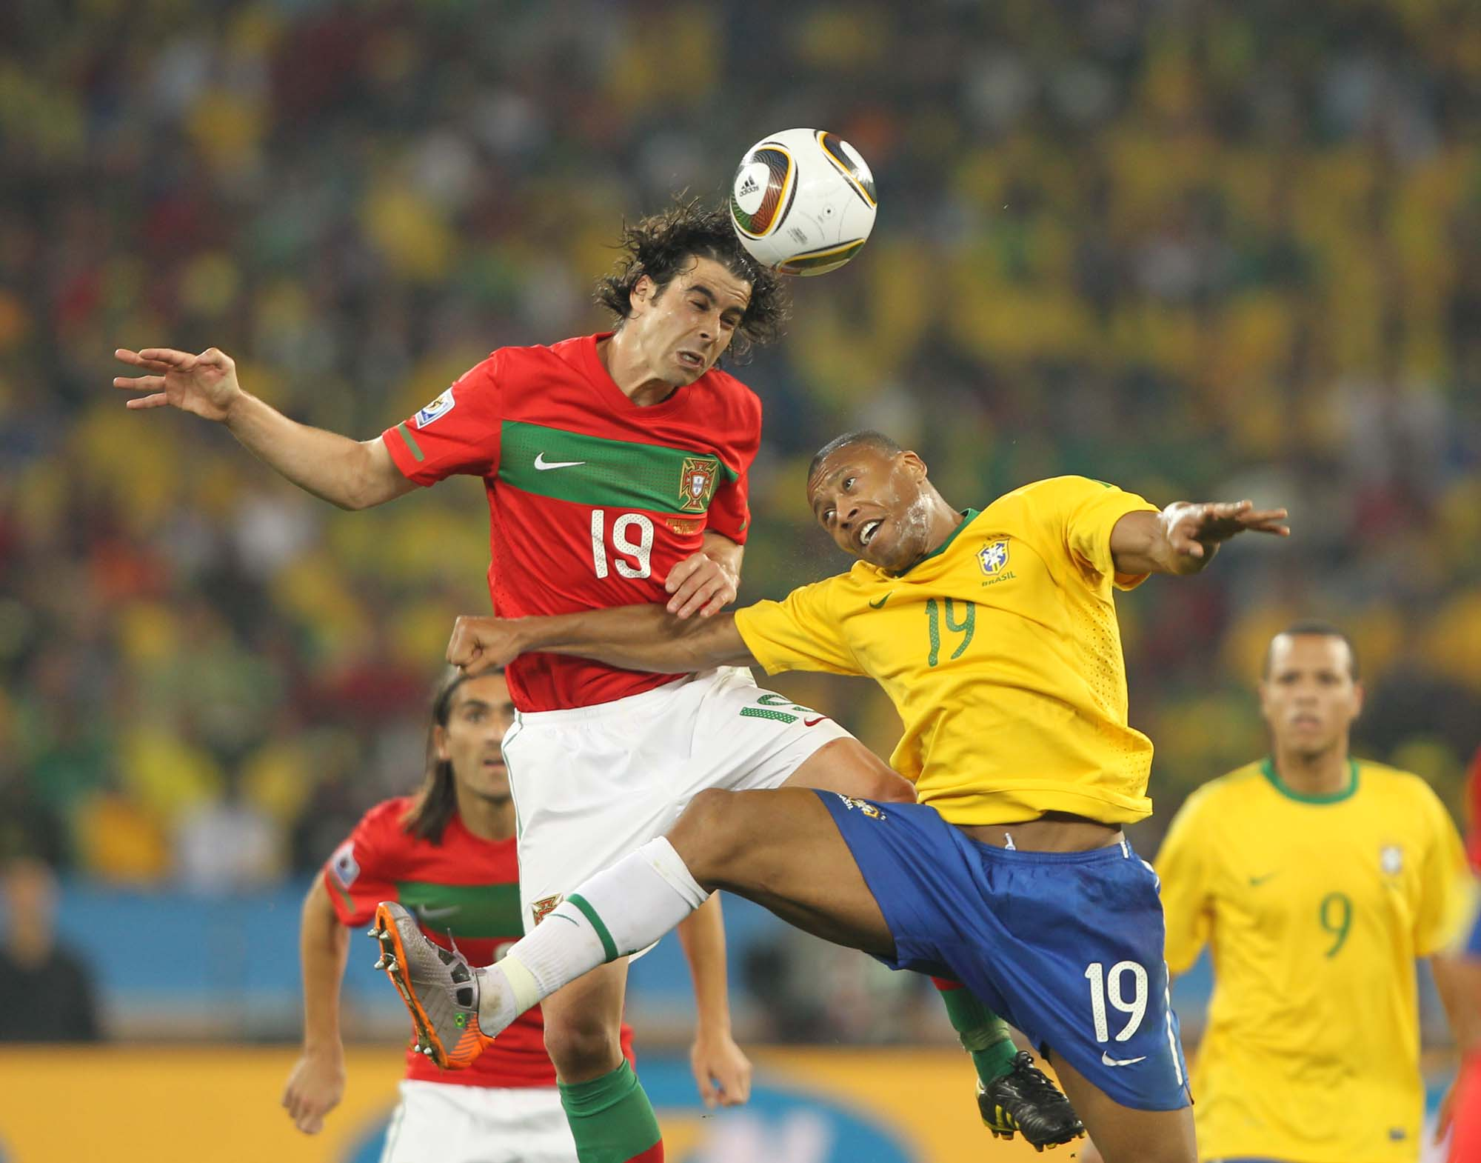
Fifty-five Per Cent Return to Competitive Sport Following Anterior Cruciate Ligament Reconstruction Surgery An Updated Systematic Review and Meta-analysis Including Aspects of Physical Functioning and Contextual Factors Clare L Ardern, Nicholas F Taylor, Julian A Feller, Kate E Webster Br J Sports Med. 2014;48(21):1543-1552.
Sixty-nine articles, reporting on 7556 participants, were reviewed. On average, 81% of people returned to any sport, 65% returned to their pre injury level of sport and 55% returned to competitive level sport after surgery.

Slide 20
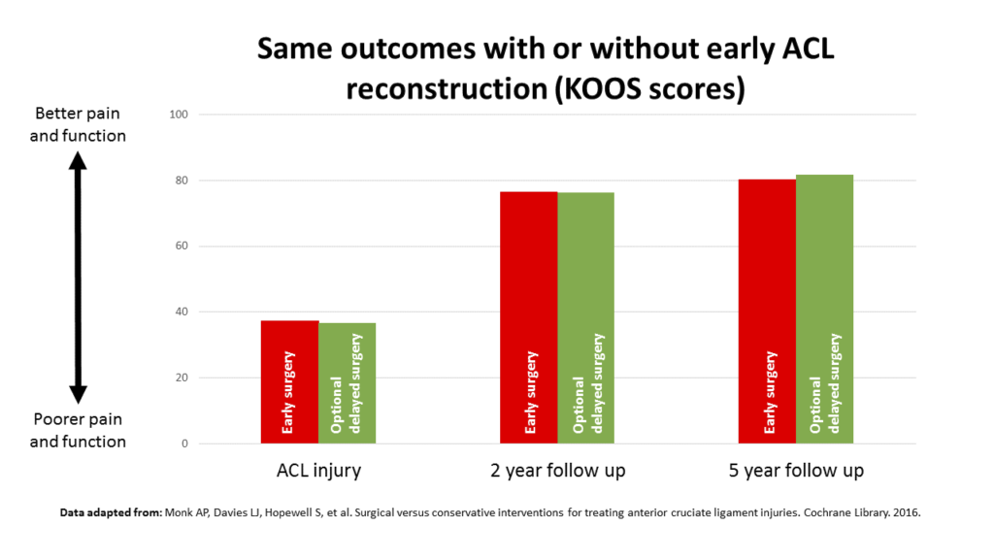
“Having an ACL reconstruction does not mean you automatically go back to playing sport.”
Just as importantly, when we look at the evidence, some athletes can return to sport without surgery, says Dr Ardern. There are two main treatment options available to someone who has recently injured their ACL:
Choosing to have surgery early combined with exercise rehabilitation
Attempting exercise rehabilitation without surgery, with the option of delayed surgery if the person is not satisfied with the outcome
“The best quality evidence shows us that the patient reported outcomes are similar, and the return to sport outcomes are similar irrespective of (which of these two) treatments that you choose”

Slide 21
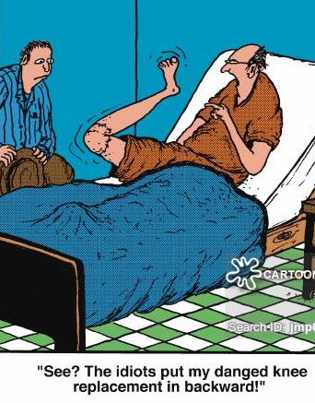
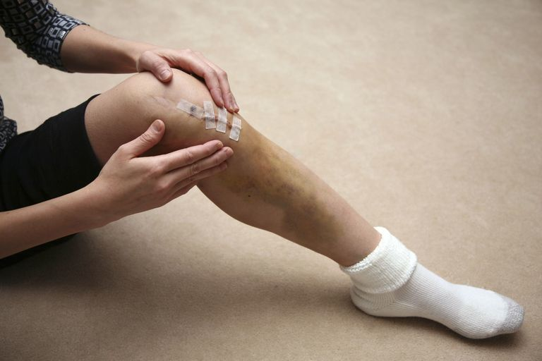
COMPLICATIONS

Slide 22
ACL RECONSTRUCTION COMPLICATIONS – WAT`S NEW?
Am J Sports Med August 2013 vol. 41 no. 8 1780-1785 Incidence of Postoperative Anterior Cruciate Ligament Reconstruction Infections. Graft Choice Makes a DifferenceGregory B. Maletis, MD*, Maria C.S. Inacio, MS†‡, Sarah Reynolds, MPT*, Jamie L. Desmond, MPH†, Michela M. Maletis, BS* and Tadashi T. Funahashi, MD*
Conclusion: An 8.2-times higher risk of SSIs was observed in hamstring tendon autografts compared with BPTB autografts.
No difference in SSI incidence was identified between allografts and BPTB autografts. Surgeons should bear in mind that although the overall infection rates after ACLR are low, there is an increased risk of deep infections with hamstring tendon autografts.
Arthroscopy. 2006 Apr;22(4):375-84.Infections following arthroscopic anterior cruciate ligament reconstruction.Judd D, Bottoni C, Kim D, Burke M, Hooker S. Eleven postoperative infections were identified, between 1994 and 2002, all in patients who had hamstring autograft

Slide 23
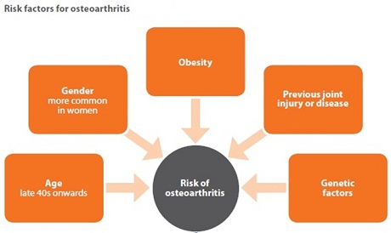
DOES EVOLUTION TO ARTHRITIS MATTER?
Although the reconstruction procedure achieves good results, reconstruction has its pitfalls. Patients undergoing reconstruction are at risk for osteoarthritis (OA) — about 75% will develop OA 15-years post-reconstruction — but they are largely unaware, according to Snyder-Mackler.
“Roughly, 98% of individuals who are undergoing ACL reconstruction believe they have no or only a little higher risk for any OA,” she said. “We are not doing a good job of presenting this information.”
Freddie H. Fu: I believe that restoring knee stability through ACL reconstruction is an important factor in decreasing the incidence of degenerative changes after rupture of the ACL; however, it is not the only factor.

Slide 24
No difference in osteoarthritis after surgical and non-surgical treatment of ACL-injured knees after 10 years.Tsoukas D, Fotopoulos V, Basdekis G, Makridis KG.Knee Surg Sports Traumatol Arthrosc. 2015 Apr 9
ACL reconstruction using hamstrings autograft resulted in better functional outcome and laxity measurements than ACL-conservative management.
However, the incidence of radiological osteoarthritis was similar between the two groups and independent on the pre-operative grade of laxity and functional status of the patients
Equally, bone bruises were not found as a risk factor for the development of osteoarthritis after ACL rupture

Slide 25
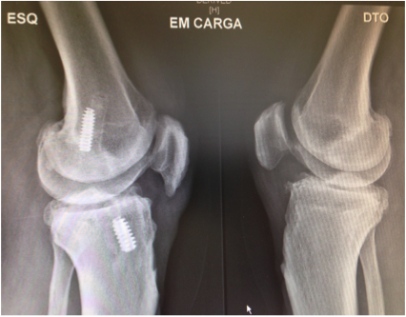
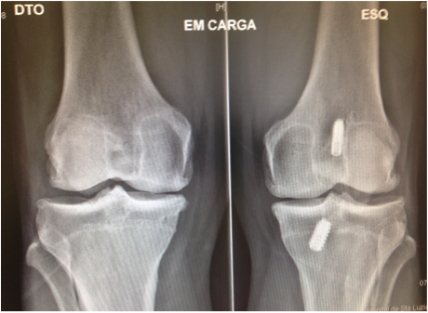
Male, 44 years old, ex football player, bilateral ACL rupture. Left knee surgery 9 years ago, right knee injury 8 years ago, conservative treatment

Slide 26
REINJURIES: THE NIGHTMARE FOR PLAYERS AND CLINICIANS
Re-injury rate is sometimes considered as an instrument to measure the skills of medical staff.
In fact, if injury incidence is mainly affected by technical and performance activities then re-injuries, as determined by an early return to play and incomplete rehabilitation, are often associated with medical staff performance.

Slide 27
ETIOLOGY OF ACL GRAFT FAILURE
University of Pittsburgh Classification

Slide 28
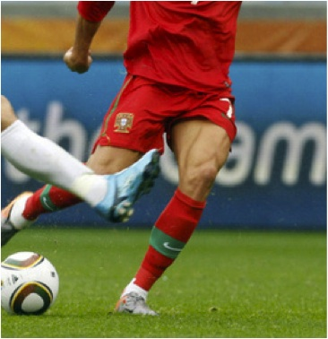

Slide 29
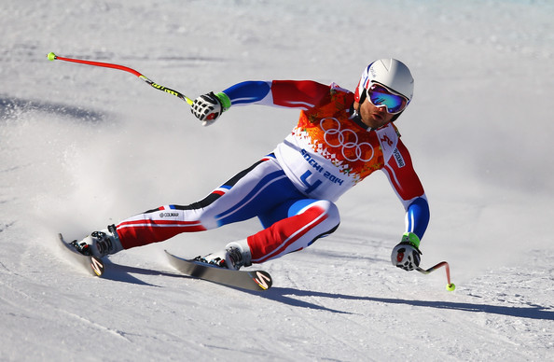
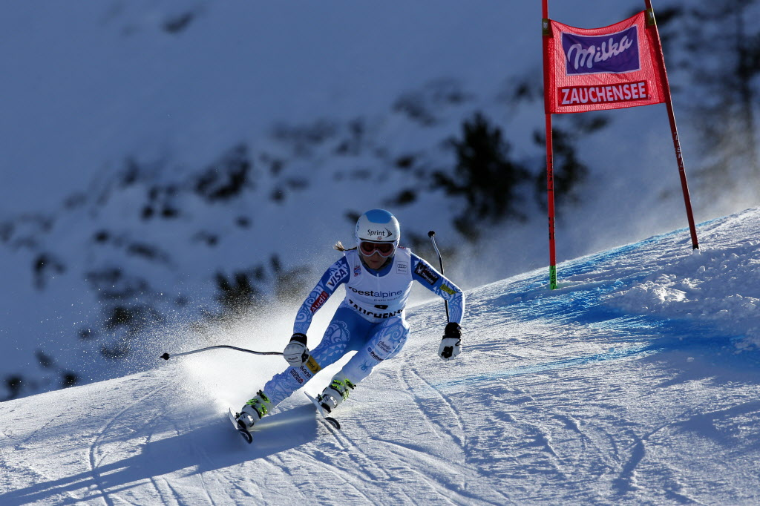

Slide 30
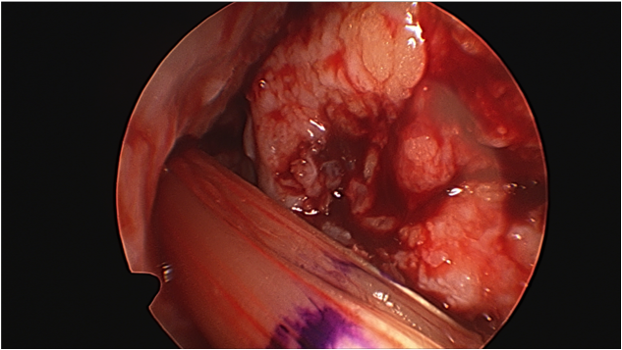
IS ACL RECONSTRUCTION, ONLY, A SAVE THE MENISCUS PROCEDURE?

Slide 31
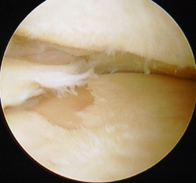
Knee Surgery, Sports Traumatology, Arthroscopy May 2008, Volume 16, Issue 5, pp 442-448 Function, osteoarthritis and activity after ACL-rupture: 11 years follow-up results of conservative versus reconstructive treatmentM. A. Kessler, H. Behrend, S. Henz, G. Stutz, A. Rukavina, M. S. Kuster
Eleven years after ACL-rupture the physical activity levels are similar for both groups.
After ACL-reconstruction, stability is higher as is osteoarthritis, whereby the result is not necessarily perceived as better subjectively
Specifically, this retrospective study yielded a 24% incidence of oseoarthrits 11 years after conservative management of ACL-rupture in patients not needing secondary surgery
The risk of secondary meniscal tears is reduced after ACL reconstruction, which reduces the negative effects of OA after surgery
The ultimate objective would be to achieve a good subjective outcome by conservative treatment followed by a rehabilitation program designed to keep secondary meniscus tears at a low level.

Slide 32
Options for non operative treatment of ACL injuries exist, but remain controversial Orthopaedics Today Europe, November 2016
“There are a lot of scientific articles, [and] there are a lot of talks on the topic and experts’ opinions saying that if you want to return to sports, you need an ACL reconstruction,” Richard B. Frobell, PhD, of the Department of Orthopaedics at Lund University in Lund, Sweden, told Orthopaedics Today Europe. “The problem is that there is little evidence to support that.”
Patients have come to believe this idea: 98% of athletes think a return to pre-injury activity level is possible, according to Lynn Synder-Mackler, PT, ATC, ScD, SCS, FAPTA, professor in the Department of Physical Therapy at the University of Delaware in Newark, Del., USA. However, the literature shows 55% to 65% of athletes with ACL injuries return to sports, she said.

Slide 33
“Anatomic ACL reconstruction is defined as the functional restoration of the ACL to its native dimensions, collagen orientation and insertion sites”

Slide 34
THE BEST TECHNIQUE IN 2016?!
Magnus Forssblad

Slide 35
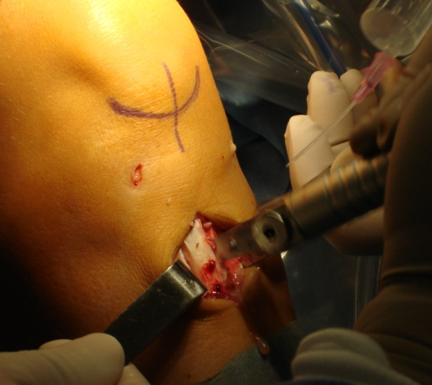
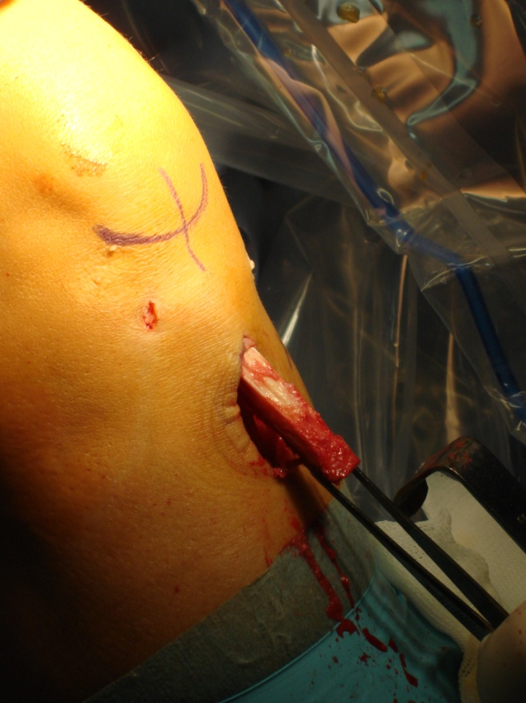
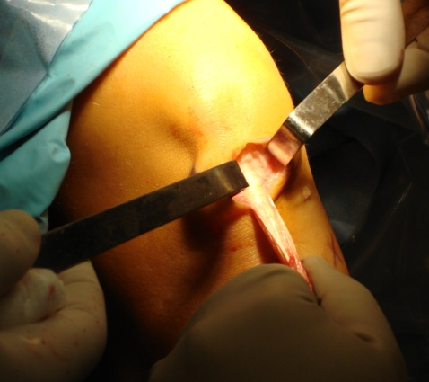
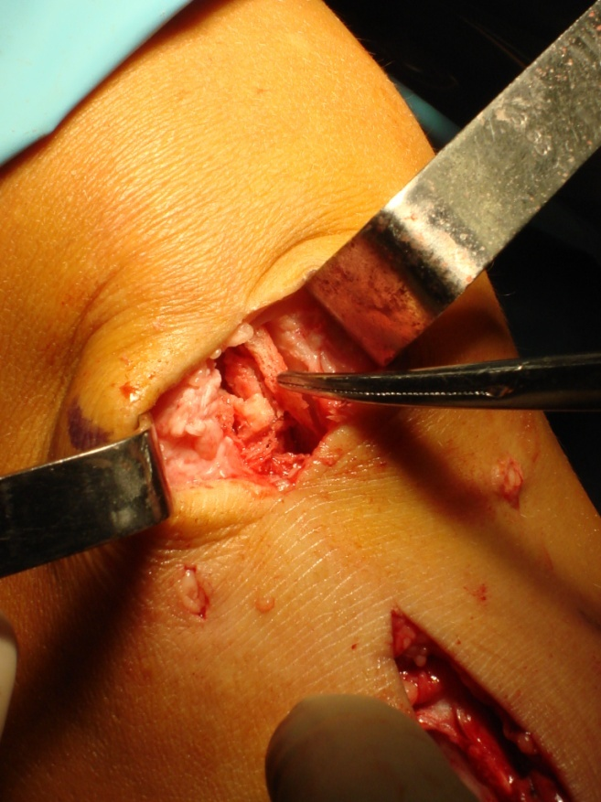
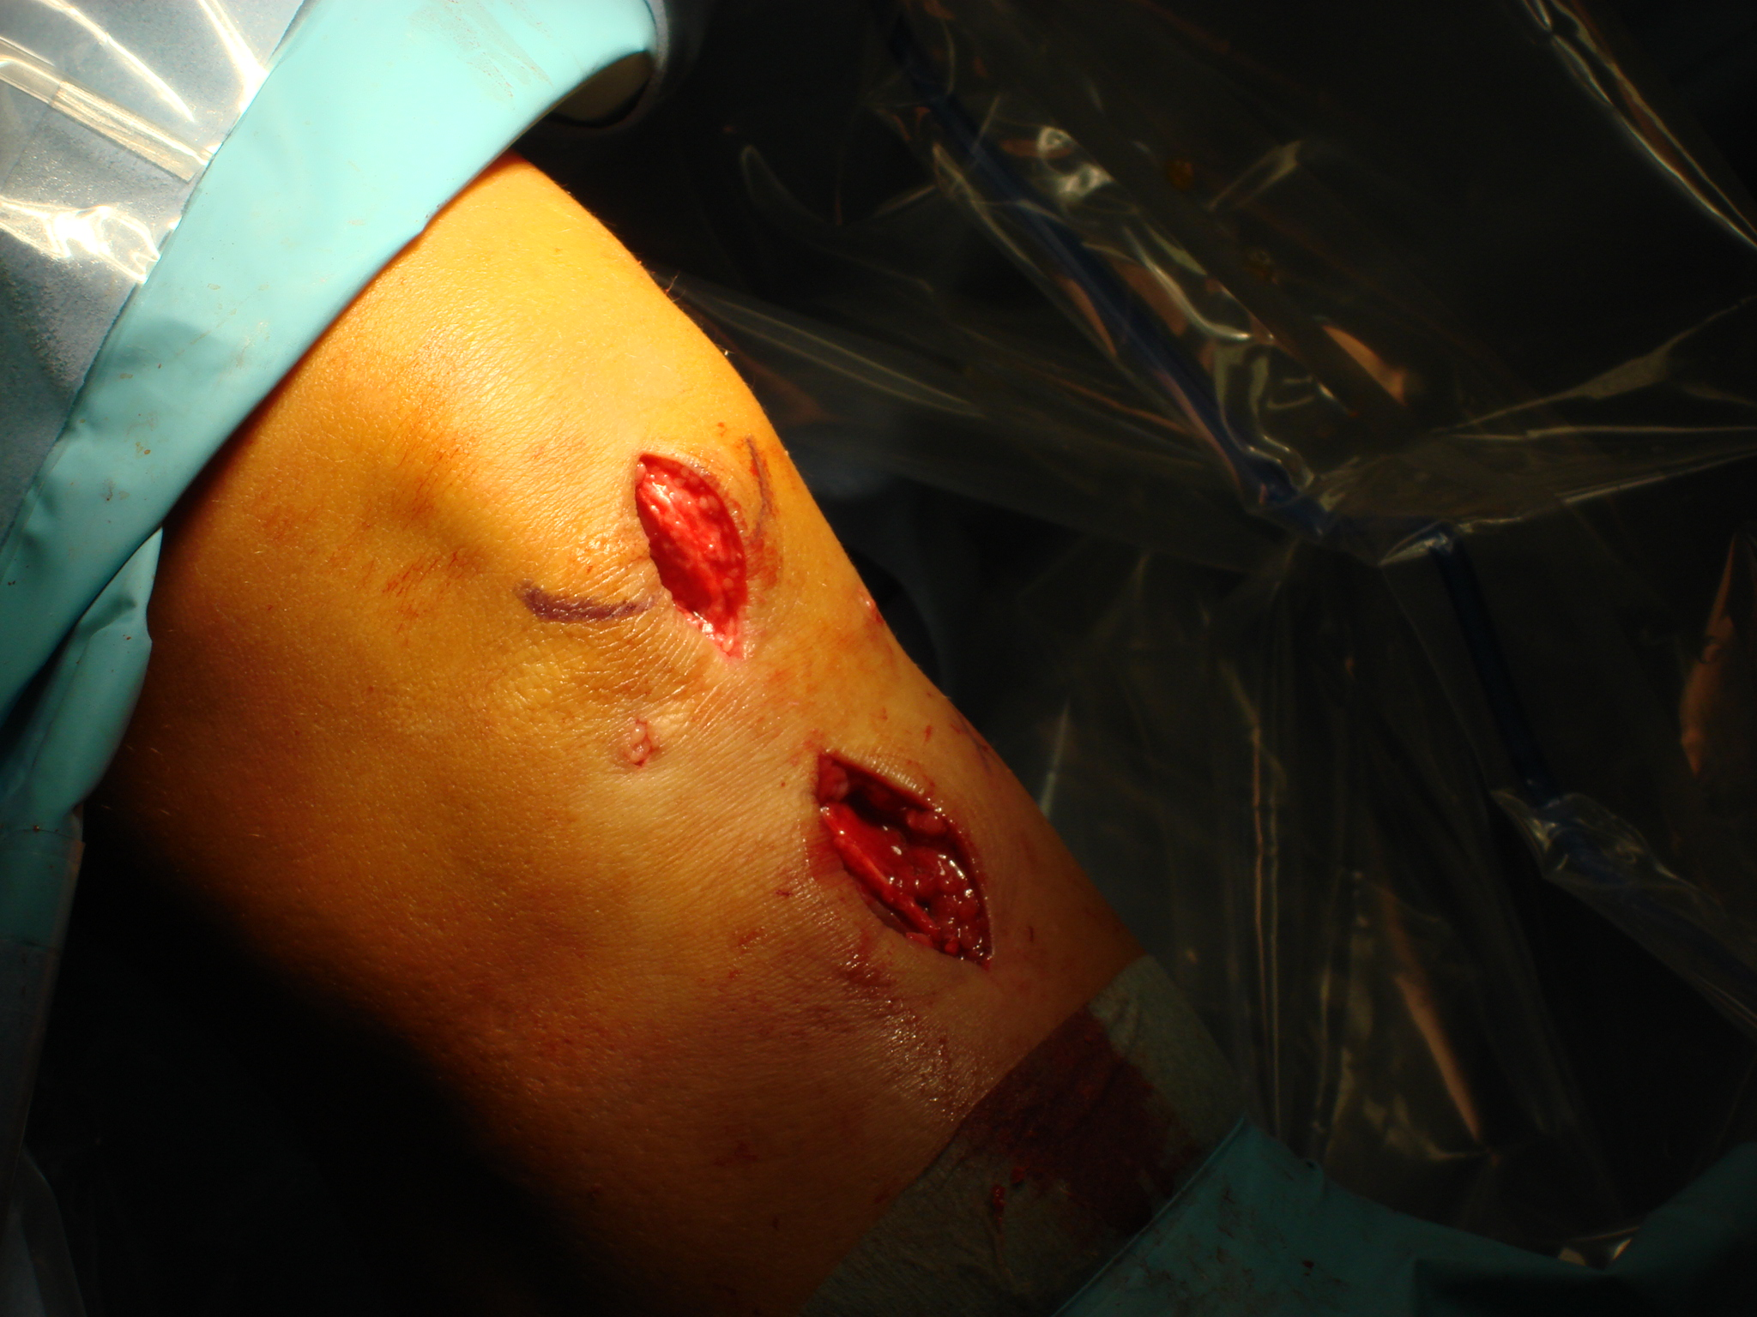
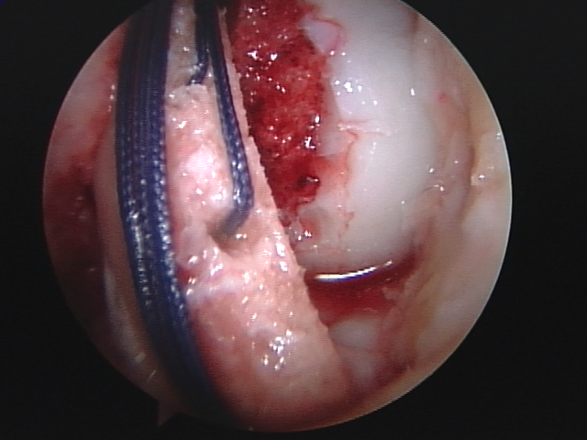
TAKE HOME MESSAGES
It seems that the best graft for football players undergoing ACL reconstruction has yet to be determined no matter gender or obesity
With the advent of new techniques and technology, as well as the undertaking of larger more comprehensive studies, this may change in the future.
For now, patellar tendon autografts and hamstring tendon autografts (>8mm size) are both viable options for ACL reconstruction in adults football players although individualize option must be present.
Apparent consensus in top football players, including females, seems to be : individualized, single band, patella tendon, interferential screws, adequate rehabilitation and return to sports around 6 months after surgery.

Slide 36
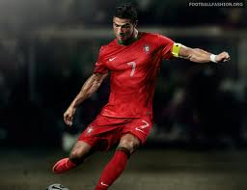
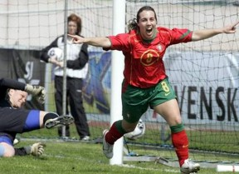
FACTS AND REALITY – ARE WE SURE ABOUT BEST PRACTICES AND GOLD STANDARDS?
NO!

Slide 37
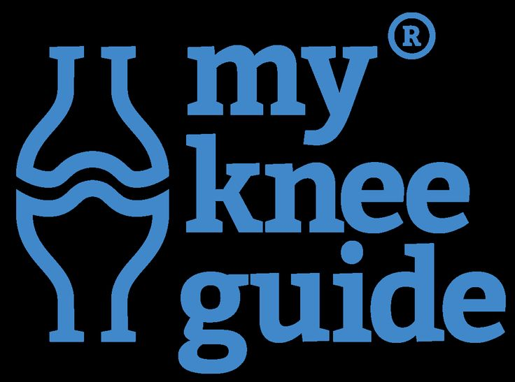
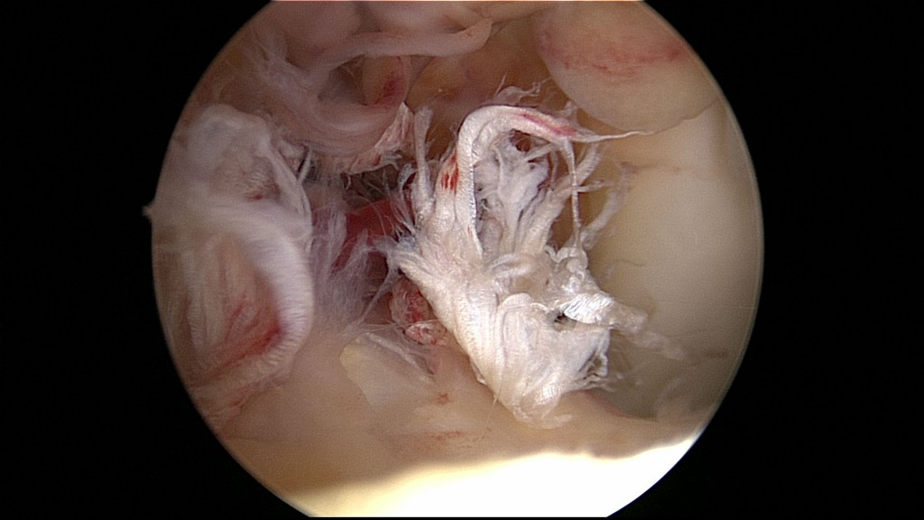
INFORMATION /EDUCATION

Slide 38
J Trauma. 2007 May;62(5):1159-62.The value of conservative treatment in ruptures of the anterior cruciate ligament (ACL).Strehl A1, Eggli S.
Although the authors performed a preoperative screening to select patients suitable for conservative treatment, almost two-thirds of the primarily conservatively treated ACL ruptures needed an operative reconstruction in the long term
In one-third of the patients, conservative treatment led to a good or very good result
At the endpoint of the study only 12 (16%) of a total of 73 patients with acute injuries of the ACL had successful conservative treatment
Therefore, patients must be comprehensively instructed about the treatment program and the chances of success of conservative ACL treatment

Slide 39
Knee Surg Sports Traumatol Arthrosc. 2012 Jan;20(1):48-61 Anterior cruciate ligament tears: conservative or surgical treatment? A critical review of the literature.Delincé P1, Ghafil D.
At present there are no evidence-based arguments to recommend a systematic surgical reconstruction to any patient who tore his ACL
Knee stability can be improved not only by surgery but also by neuromuscular rehabilitation
Whatever the treatment, fully normal knee kinematics are not restored
While the patients wish to go back to their sport and want everything possible done to prolong their ability to perform these activities, they should be informed that the risk of further knee lesions and osteoarthritis remains high, whatever the treatment, surgical or conservative

Slide 40
Is Anterior Cruciate Reconstruction Superior to Conservative Treatment?Dawson AG, Hutchison JD, Sutherland AG.J Knee Surg. 2014 Dec
Patients who elect to have conservative management of an ACL rupture can achieve similar function and satisfaction to those who elect to have reconstruction
Until a large randomized controlled trial is conducted, patients need to be made aware of the merits of both management strategies and the lack of evidence of superiority of one over the other

Slide 41
“We need to end the story about having one group of individuals strongly advocating that we should not perform ACL surgery at all and another group of individuals saying that everyone needs an ACL reconstruction ... Because the truth is probably in the middle.”
Richard B. Frobell,

Slide 42
TAKE HOME MESSAGES
The incidence of further meniscus lesions could probably be reduced if the torn ACL was surgically reconstructed, but, we have no evidence to believe that this would be due to the surgical repair rather than to a decrease of involvement in strenuous activities
It is not demonstrated that ACL-plasty can prevent osteoarthritis
Studies comparing surgical and conservative treatments confirm that ACL reconstruction is not the pre-requisite for returning to sports activities, except in children and adolescents
More recent and scientifically well-designed studies demonstrate that conservative treatment could give satisfactory results for many patients ( non pivoting sports participation ???)
Patients have the right to know the the real expectations and implications between conservative and surgical treatment

Slide 43
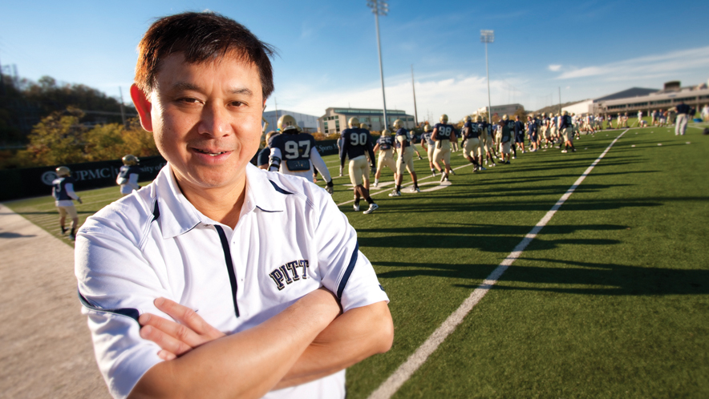
When contemplating treatment options, Fu always considers two possibilities:
First, if the injury produces daily functional problems for the patient, such as regular knee buckling, that patient should be managed with reconstruction.
Second, if the patient is willing make an activity change, he or she can pursue nonoperative treatment.
“I have an ACL tear,” Fu said. “I [changed] my lifestyle so that in 15 years, I only buckled once. I did it during a wedding, doing a ‘twist-and-shout’ dance. I just swim, bicycle, exercise on a treadmill. My lifestyle is maintained, and I am fine.”

Slide 44
ARE WE OPERATING TOO MUCH ?

